Slide 1
STRATWARS
THE STRATEGY GAME

Slide 2
Idea
It’s a basic 2 player, monster vs human, turn-based strategy game
Both sides have equal opportunity to collect the money that is randomly spread on the map
Each and every character of the game can be upgraded according to strategy of the player (Upgrade mechanics are explained ahead)
Map has a neutral NPC that is placed in the centre of the map, he sits on huge amount of money that can collected when he is killed.

Slide 3
Humans and Monsters (HnM)
At beginning - both sides have 10 HnM that have the capacity to move some blocks
Each HnM have ability to “Collect” gold and “Attack” opponent
Game ends when no one on the opponent side survives (pretty obvious)

Slide 4
Attack Mechanism
Every character has a set damage ability
Every character also has armor that reduces the % damage
There is a luck mechanism implemented in the attack process
The player can inflict a critical hit or totally miss depending on luck

Slide 5
Collection Mechanism
Players can collect gold from the map only when the block on which their character is standing upon bears it
Players cannot collect gold if it is not present in the block
This gold is necessary for upgradations of the characters of the game
Proper utilization of earned gold will enable player to upgrade characters and place them on map strategically and destroy opponent

Slide 6
Upgrade Mechanism
Each character can be upgraded to Fighters, Healers, Retrievers.
There’s a upgradation tree coded for this purpose
There are also levels to which characters can be upgraded
Eg. Level 2 Soldiers or Healers

Slide 7
Neutral NPC mechanism
Sitting in the middle of the map, this character only gets activated in aggressive mode when attacked by any character on either side
His aggression lasts for 3 turns
In every turn he shows his aggression in 2 ways:
He can either inflict area damage on everyone within 3 blocks radius from him
Or give a major blow to a single character with 3 block radius

Slide 8
Technology and Game Logic
This game is coded in Java Spring.
This place is insufficient to explain the complete game logic
However, to keep it short I have used 2-D array to maintain the map
Each block on the map is an object and so is every character
Its highly flexible game model that can be changed as and when needed

Slide 9
Room for improvement
UI can be improved and can have a beginners tutorial
Intensive testing of the game can help make a more balanced game that is addictive nature

Slide 10
To wrap up
This game was made (completely) by me in the training phase in the beginning of my first job (which I am in still). I have a passion for creating games and coding the logic. Its my hobby and I love its every process of it to the core.
I am desperately looking for an opportunity to prove myself in this field and I am confident that will be able to bear the weight of the expectations and will deliver a product that is better than expected.
Game Source Code:
https://github.com/juggernauthk108/game/raw/master/HvM2.6.zip
(Download the zip file and import it into Eclipse. It runs on Apache tomcat server 7 or greater.)
THANK YOU.

Slide 11
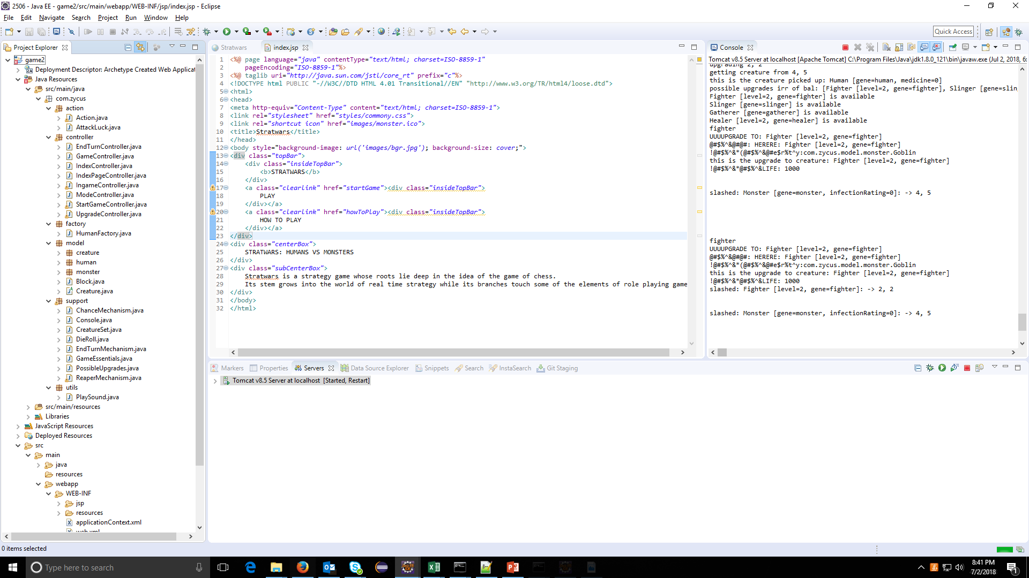

Slide 12
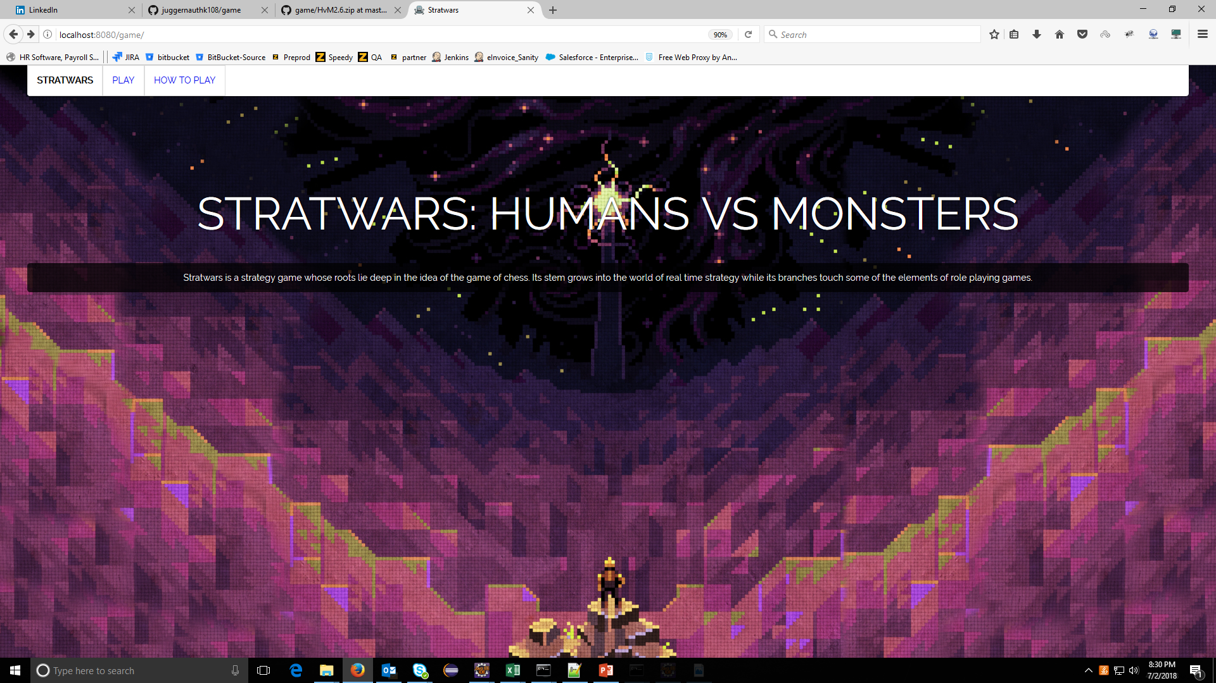

Slide 13
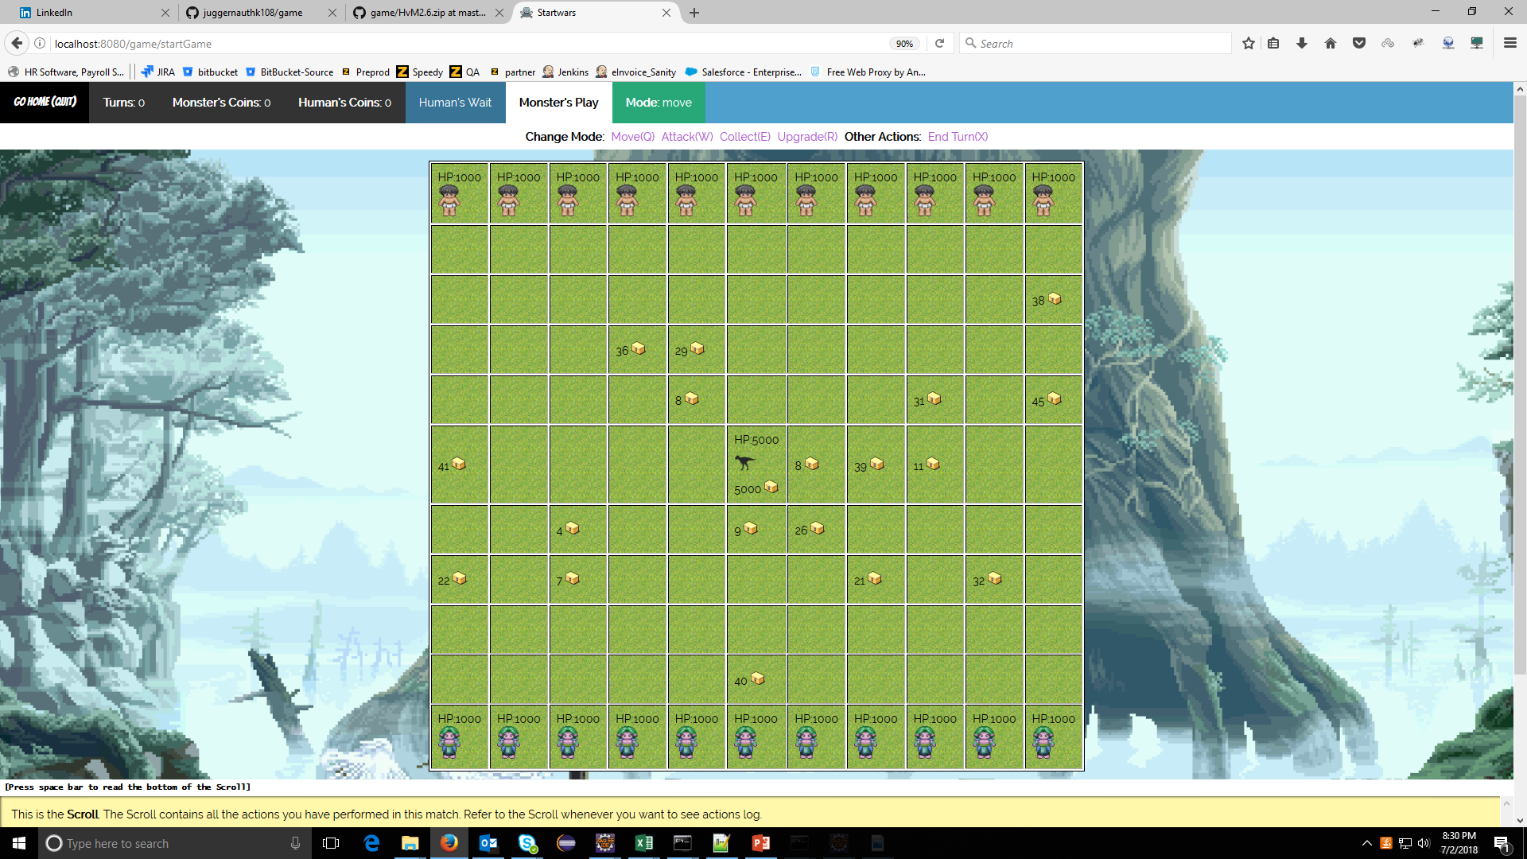

Slide 14
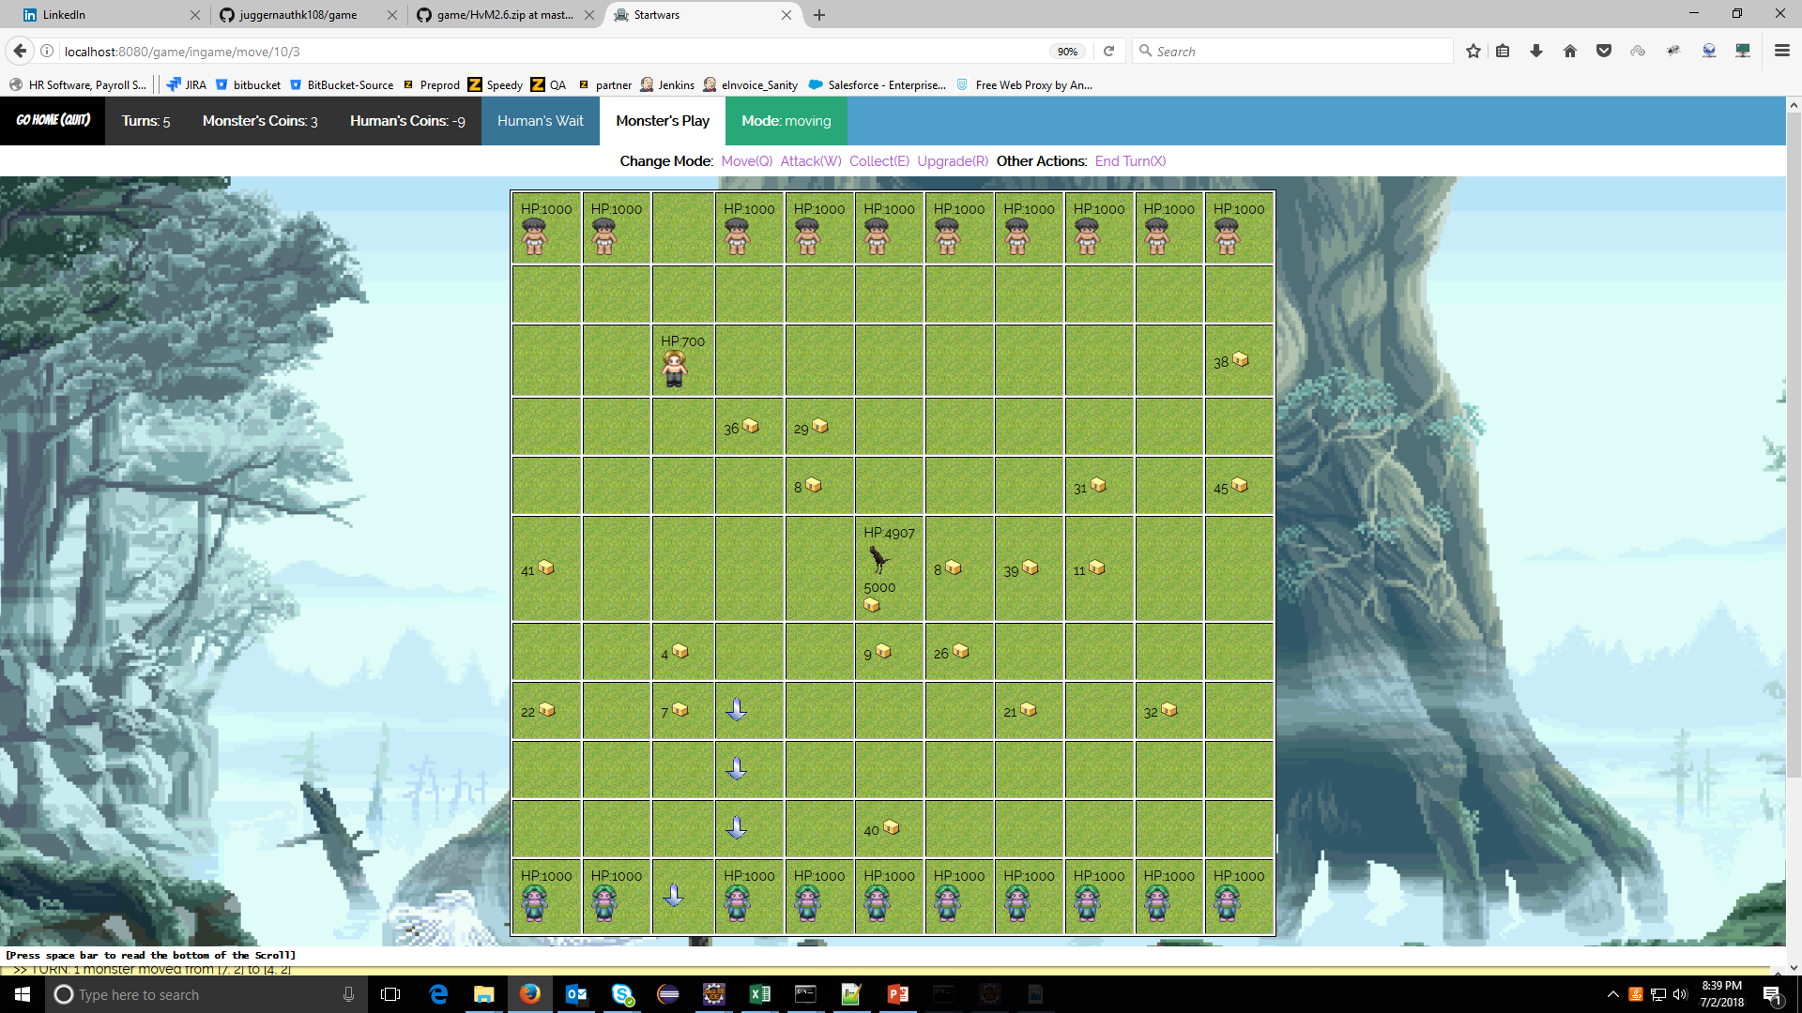

Slide 15
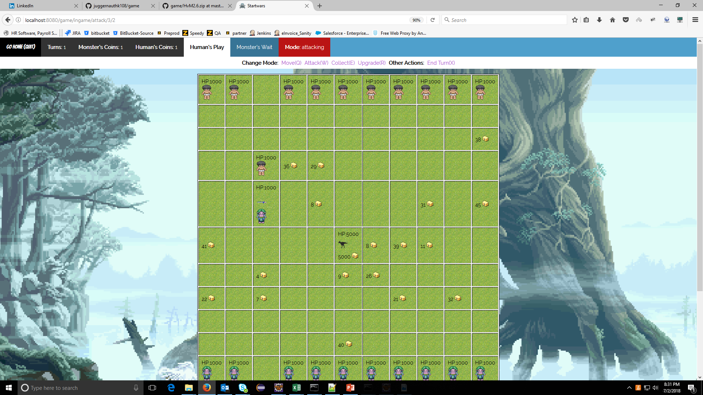

Slide 16
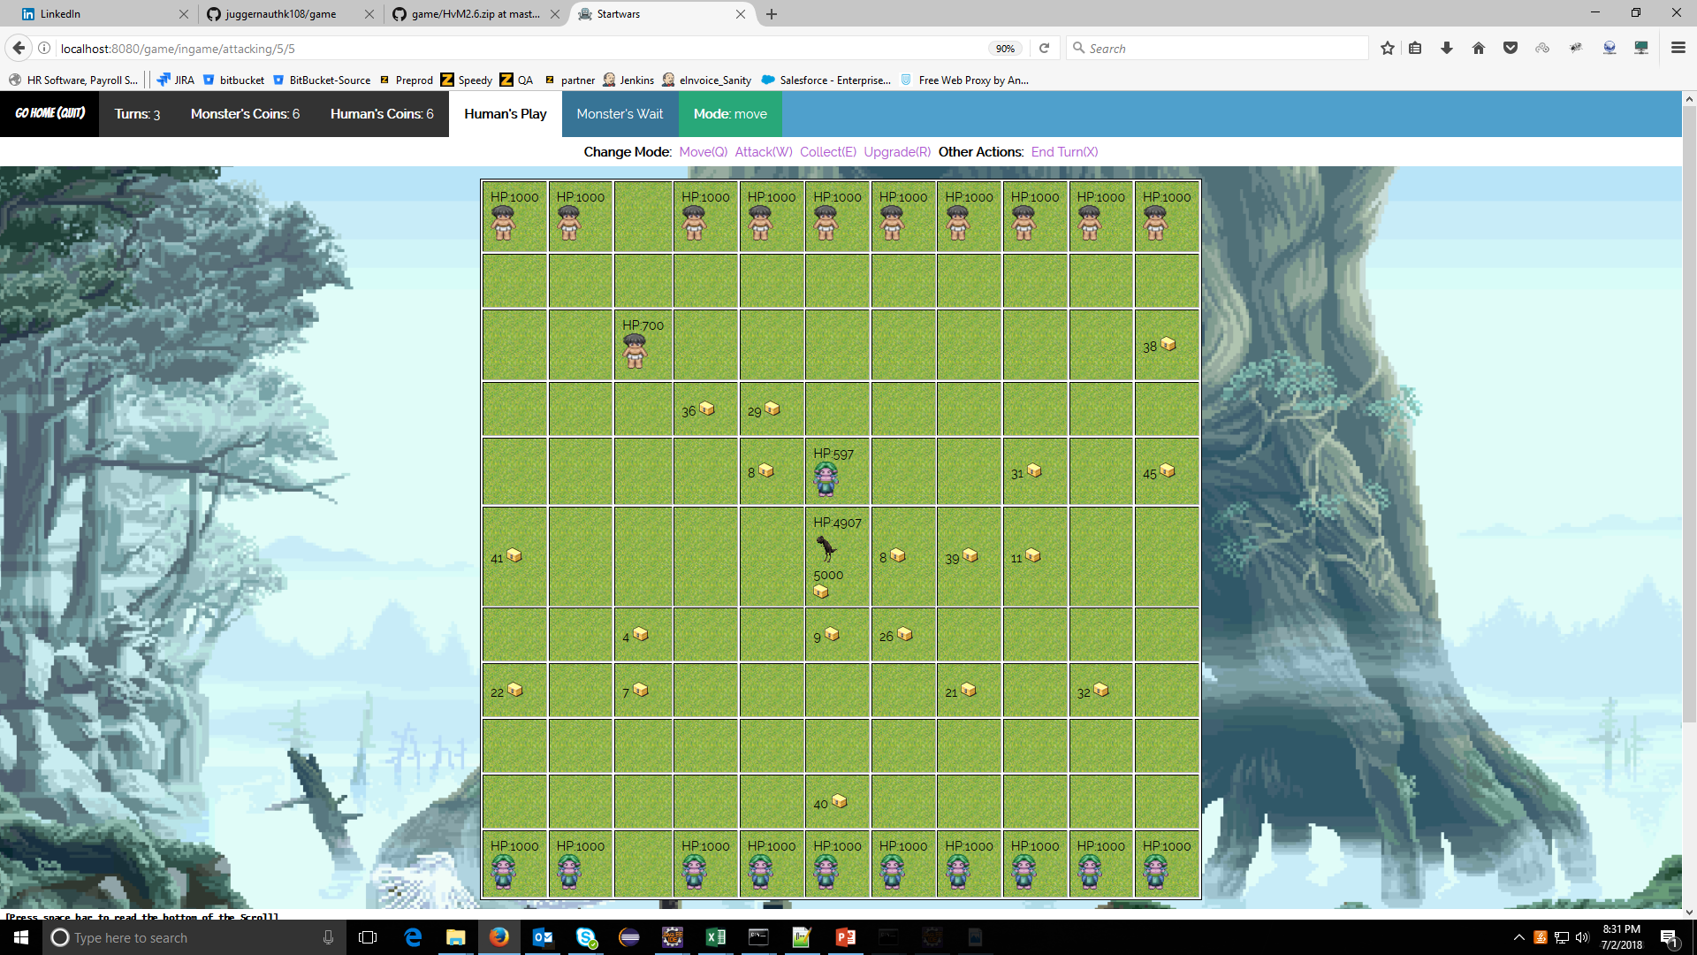

Slide 17
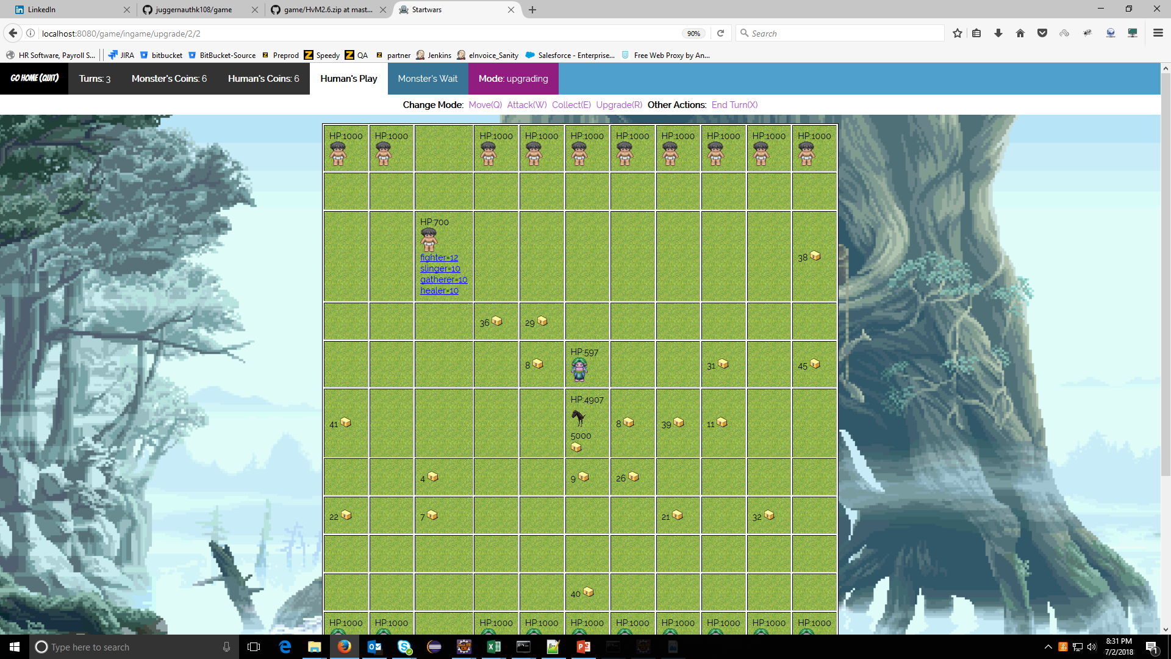

Slide 18
